Slide 1
Homicide 4 – Homicide in Context
Dr Andrew Beetham
andrew.beetham@durham.ac.uk
Academic Support & Feedback Hours: Thursday 11.00-13.00
PCL 181

Slide 2
By the end of this lecture, you should be able to:
Understand the context of homicide offences in the criminal law
Understand the impact of homicide offences regarding sentence and release
Provide an explanation of the context of homicide offences in the criminal law

Slide 3
Recap…
Homicide 1 – Murder
Homicide 2 – Voluntary Manslaughter
  Loss of Control
  Diminished Responsibility
  Suicide Pact
Homicide 3 – Involuntary Manslaughter
  Unlawful act manslaughter
  Gross negligence manslaughter

Slide 4
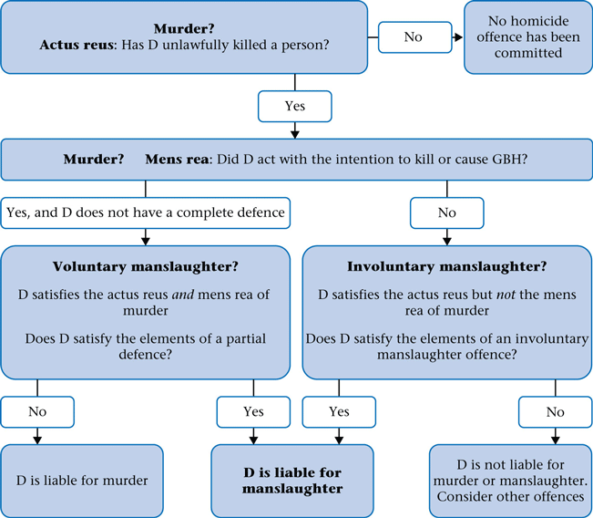
Homicide Flow Chart

Slide 5
Other Homicide Offences
Corporate manslaughter (Corporate Manslaughter Act 2007)
Driving, includes death by dangerous driving (Road Traffic Act 1988, s. 1), by careless driving (RTA 1988, s. 2B) or under influence (RTA 1988, s. 3A)
Infanticide (Infanticide Act 1938)
Child destruction (Infant Life (Preservation) Act 1929)

Slide 6
Homicide Statistics
April 2022-March 2023: 590 recorded homicides (down from 684)
Homicide rate per million population:
  9.9 overall
  14.2 for males compared to 6.0 for females
  63 in US / 3.9 in Malta
51 victims between age 13-19
  82% with a knife or sharp instrument
100 domestic homicides (17%)
  70 female victims / 30 male victims

Slide 7
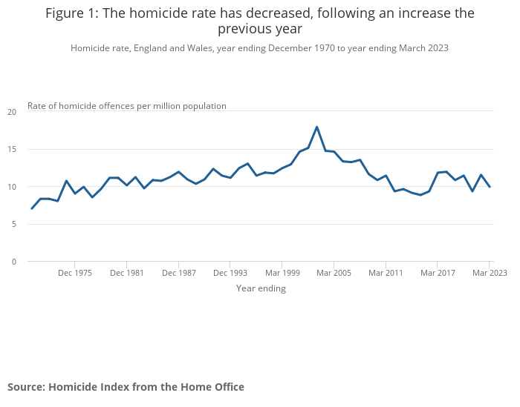
Long term trends

Slide 8
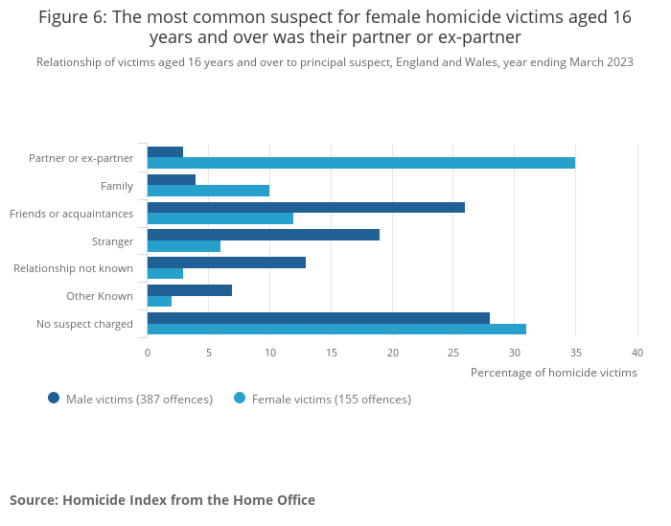
Who kills whom?

Slide 9
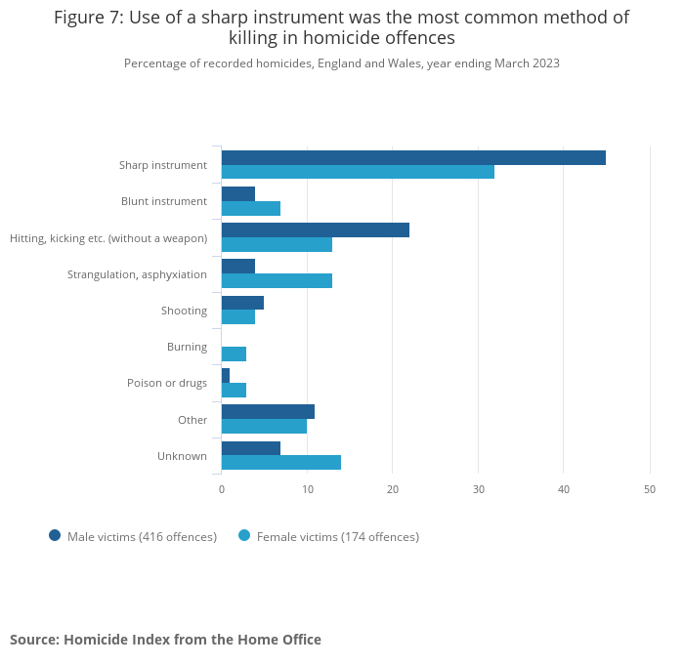
And how?

Slide 10
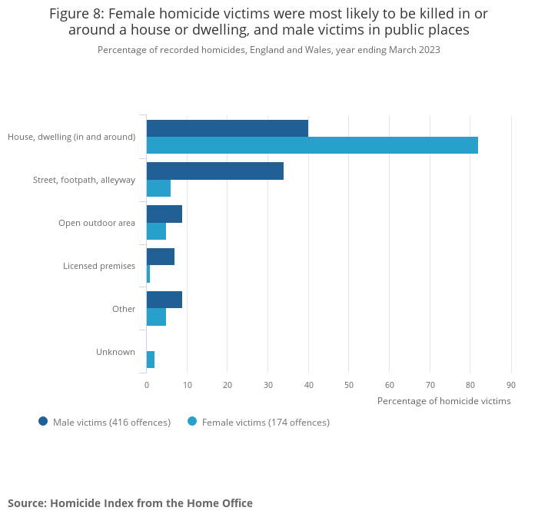
And where?

Slide 11
Sentencing for Homicide
Murder
  Under 18: Detention at His Majesty’s Pleasure
  18-21: Custody for life
  21+: mandatory life sentence
Manslaughter
  Maximum: life imprisonment
  Discretionary

Slide 12
Murder: length of minimum term
Before 2003 was decided by Home Secretary
Since 2003 was set by trial judge
High Court “reset” pre-2003 mandatory life sentences
“Minimum”

Slide 13
Starting Points for Murder
Sentencing Act 2020, Sch. 21:
  Whole life order: 21+ and “exceptionally high” (para. 2)
  30 years: 18+ and “particularly high” (para. 3)
  25 years: 18+ with a knife or other weapon (para. 4)
  15 years: 18+ and not within the above (para. 5)
  12 years: under 18 (para. 6)
Can result in any length with aggravating and mitigating factors (para. 8)

Slide 14
Young Offenders
1 | 2 | 3 | 4
Age of offender when offence committed | Starting point supplied by paragraph 3(1) had offender been 18 | Starting point supplied by paragraph 4(1) had offender been 18 | Starting point supplied by paragraph 5 had offender been 18
17 | 27 years | 23 years | 14 years
15 or 16 | 20 years | 17 years | 10 years
14 or under | 15 years | 13 years | 8 years

Slide 15
Release of Life Sentence Prisoners
Parole Board
No longer necessary for the protection of the public that remain confined
Life licence
Recall to prison

Slide 16
Reform of Homicide Offences
Mandatory life sentence
  Political compromise given the alternative
  Draconian given the existence of possibility for release
  Broad spectrum of murderers
  No judicial discretion, only upon minimum term
Partial defences
  Gender bias
  Qualifying triggers
  Justice seen to be done?

Slide 17
Mitigation
  Extenuating circumstances to prevent mandatory life sentence
Intention to cause GBH
  Fair label as a murderer?
Laddering of offences
  Degrees of murder and manslaughter
Law Commission report 2006 (LawCom 304)

Slide 18
Next time…
Theft Offences

